Slide 1


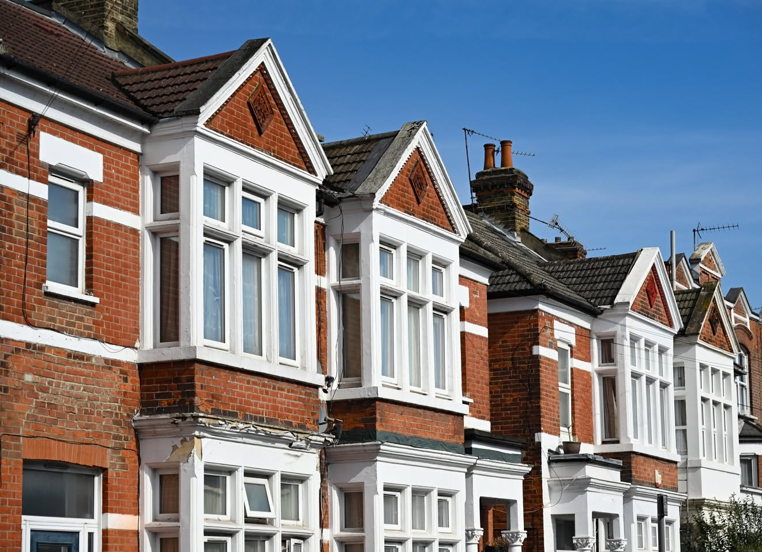



Brent Council
Resident Attitudes Survey 2026
Key findings summary
August 2026
Head office: 3 Pavilion Lane,
Strines, Stockport, Cheshire, SK6 7GH
+44 (0)1663 767 857 | djsresearch.co.uk
JN10735

Slide 2
Resident Attitudes Survey 2026: key findings
This report provides a summary of the key findings from the most recent Resident Attitudes Survey, giving an overview of what residents told us about living in Brent and their views of the council and local area.
The full report provides more detailed findings and analysis, including breakdowns by different groups of residents, comparisons with previous surveys and other benchmarks, and further information about the survey methodology.
We encourage residents, partners, community organisations and council services to use these findings to:
understand residents’ experiences, views and priorities;
inform conversations, planning and decision-making across the borough;
identify areas where further discussion, engagement or analysis may be useful; and
help shape how organisations across Brent respond to what residents have told us.

Slide 3








Key results
﻿
﻿
﻿
﻿
﻿
﻿
﻿
﻿
Satisfaction with local area
Satisfaction with Council
Value for money
Council acts
on concerns
90%↑
2021: 81%
LGA: 72%
77%↑
2021: 72%
LGA: 51%
56%↑
2021: 51%**
LGA: 38%
71%
2021: N/A
LGA: 53%
﻿
﻿
﻿
﻿
﻿
﻿
﻿
Brent Council’s key results have improved compared to both 2018 and 2021, and compare favourably relative to LGA and London borough benchmarking
Council keeps residents informed
Feelings of safety during the day
Feelings of safety after dark
80%↑
2021: 64%**
LGA: 49%
98%
2021: N/A
LGA*: 91%
59%
2021: N/A
LGA*: 71%

Slide 4
Executive summary (I)
Satisfaction with the local area
is at its highest
level to date and among the best
in London.
90%
Nine in ten residents are satisfied with Brent as a place to live, up 9% points since 2021 and 18% points above the LGA benchmark, placing it among the top London boroughs.
Top drivers
Areas to improve
Satisfaction is primarily driven by pride in Brent (76%) and a sense that people in the local area are treated fairly (77%).
Executive summary (I)
Statistical analysis reveals that problems most likely to make residents less satisfied with their local area are rubbish or litter (65%) or people being drunk or rowdy (41%). It should be noted that other issues that were not explicitly covered in the survey may also impact satisfaction.

Slide 5
Executive summary (II)
Satisfaction
with the way
the council runs things has risen again and far exceeds national benchmarks.
77%
of residents are satisfied with the way the council runs things, up 5% points on 2021.
Only 7% are dissatisfied, with the remainder neutral (15%). However, satisfaction is somewhat soft, with only 6% very satisfied with the council’s performance.
+26
Top three drivers of council satisfaction
Keeping its promises
to local people
Being helpful
Acting on the concerns of local residents
A score of 77% places Brent 26% points above the LGA benchmark and among the top performing London Boroughs for this metric.
Executive summary (II)

Slide 6
Executive summary (III)
Residents want investment to help them feel safe in
their local area, have good access to health services, and to keep the streets clean
and tidy.
38%
The most popular spending priority concerns improving community safety. This is reinforced
by a rising percentage who feel that hate crime (+14% points) and drug dealing (+12% points ) are problems in their local area.
36%
Health services is the second biggest spending priority among residents, followed by creating
a clean environment through rubbish collection/ recycling (23%) and street cleaning (23%).
Executive summary (III)

Slide 7
Executive summary (IV)
54%
Residents tend to get their information
from leaflets and noticeboards or from family, friends or neighbours (46%), but council sources such as “Your Brent Magazine” and the council’s website also feature prominently (both 38%).
Four in five
residents feel informed, and Brent comfortably outperforms the LGA’s benchmark
for this metric.
The youngest (16-24: 73%) and oldest
(65+: 74%) age groups are both less likely
to feel informed than average (80%),
indicating that targeted communications may
be needed to improve reach.
Executive summary (IV)

Slide 8
Executive summary (V)
38%
Furthermore, nearly two in five residents report experiencing some form of financial difficulty in the past 12 months.
Residents most commonly
report struggling with bills such as:
Around one in seven residents (15%) are finding it difficult
or very difficult to cope with the cost of living.
Executive summary (VII)
16%
13%
10%
9%
Fuel & energy
Rent/
mortgage
Water
bill
Council
tax

